Slide 1
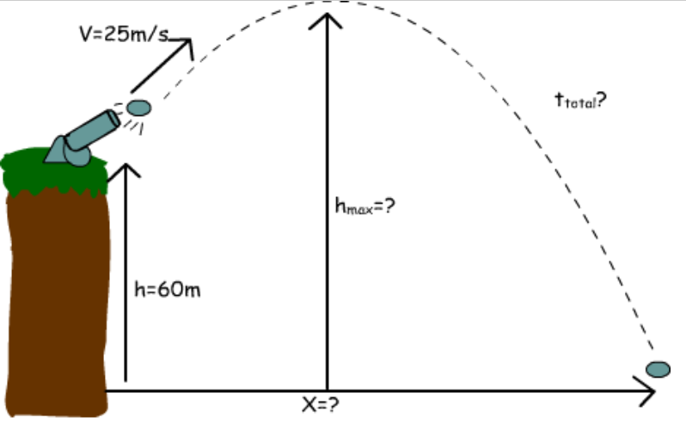
projectiles
An Introduction
Joe Kennedy, Coláiste Bhaile Chláir

Slide 2
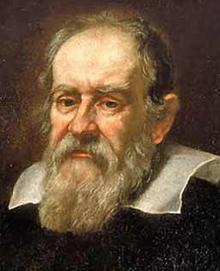
Brief history
The main man!
  Galileo Galilei
First person to show that projectiles could be analysed by analysing horizontal and vertical components separately.
Discovered that the path of a projectile follows a precise mathematical curve called a parabola.

Slide 3
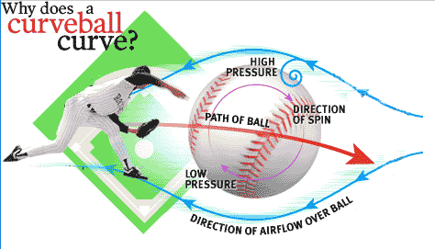

Sports 1: baseball
Projectile motion arises in a number of different sports.
The invention of the curveball is credited to Arthur "Candy" Cummings, who was a pitcher for the Brooklyn Excelsiors at the age of 18 in 1867.

Slide 4
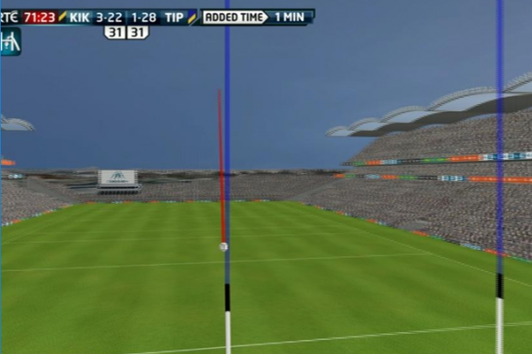
Sports 2: hurling
The Hawk Eye technology used in Croke Park could only be developed with a very good understanding of projectile motion.

Slide 5


Sports 3: golf
19th century (Scotland): a rough ball would travel further than a smooth ball.
U.S. golf balls have 336 dimples.
British golf balls have 330 dimples.
World Record competition drive: Mike Austin (471m) at Pype Hayes Golf Course

Slide 6
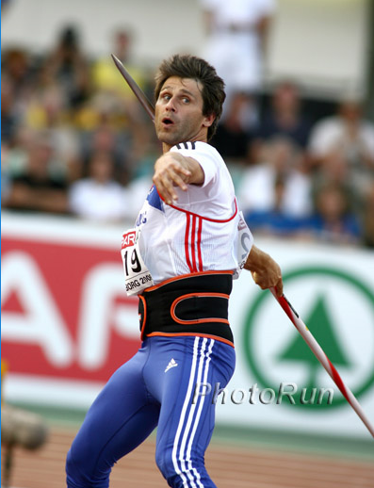
Sports 4: javelin
1984 (East Germany)
  1st man to throw over 100m
  Uwe Hohn – 104.8m
1986
  New specifications came in
1991
  Serrated tails banned
1996
  Jan Železný (Czech Republic) - 98.48m

Slide 7
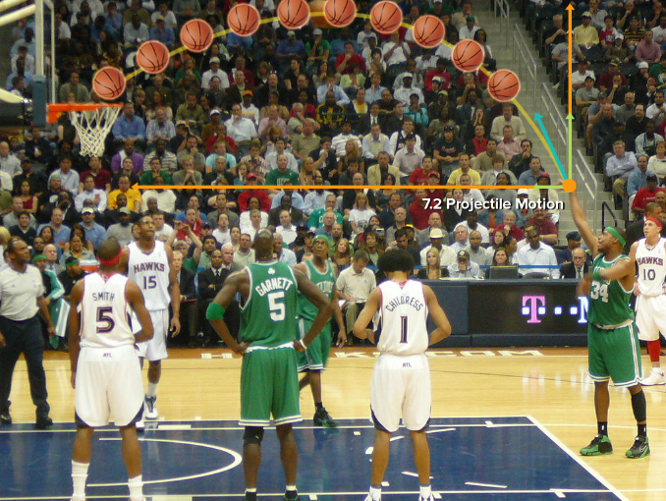
Sports 5: basketball

Slide 8
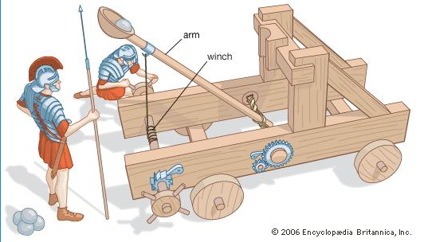

Military 1
From the catapults of Roman times to the cannons that appeared in the early Renaissance to the heavy artillery of today, armies have been shooting projectiles against their enemies.

Slide 9
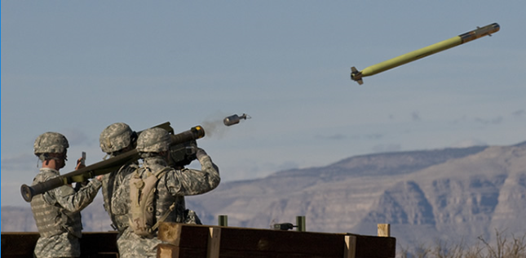
Military 2
By the 1970s, the U.S. developed an extraordinarily sophisticated surface-to-air missile, called the Stinger.
Stingers proved vital in the Afghan-Soviet War (1979-89), when U.S.-supplied Afghan guerrillas used them against Soviet aircraft.

Slide 10
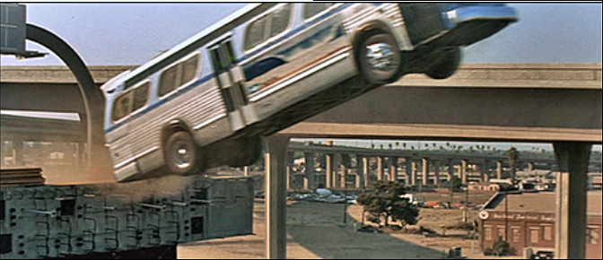

film stunts
A very good understanding of projectile motion is required to design and choreograph stunts in the film industry.
Every possible precaution needs to be taken to ensure the safety of stunt men or women involved, as well as all the crew.

Slide 11


Slide 12


Slide 13
Projectiles in action
1) Speed Movie CLIP - Jumping the Gap (1994) HD
2) 2 Fast 2 Furious Movie CLIP - Car Meets Boat (2003) HD

Slide 14


