Slide 1
Uniform acceleration
An Introduction
Joe Kennedy, Coláiste Bhaile Chláir

Slide 2
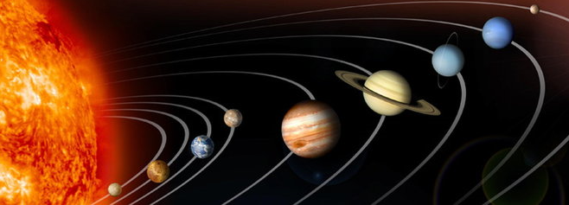
Brief history 1
Historically, the study of uniform acceleration and the equations that go with it, first appeared to describe the motion of massive objects, like the planets.

Slide 3

Brief history 2
Laws of uniformly accelerated motion apply to non-aerodynamic objects, such as humans and cars.
  Examples: high jumping, basketball
Laws don’t apply to aerodynamic objects like discus, javelin and airplanes.
  Shape of aerodynamic objects lead them to be influenced by factors like lift and drag.

Slide 4
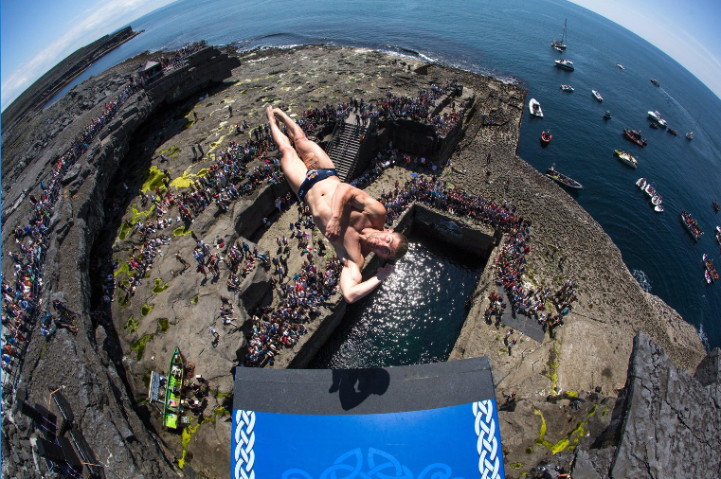
Cliff diving
Uniform acceleration applies when an athlete leaps from a high cliff and does various moves like somersaults and vertical twists during the free fall.
Red Bull Cliff Diving on the Aran Islands

Slide 5
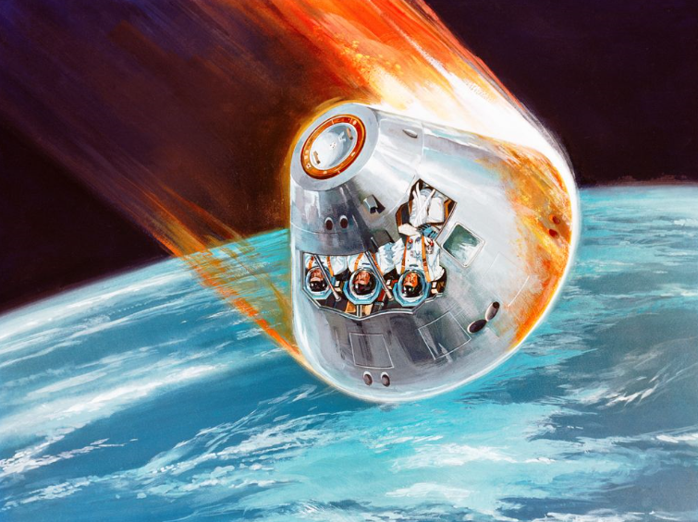
space
Another example of uniform acceleration would be when a space capsule detaches from the international space station and hurtles down towards Earth under the influence of gravity.
This knowledge can be used to design the capsule.

Slide 6
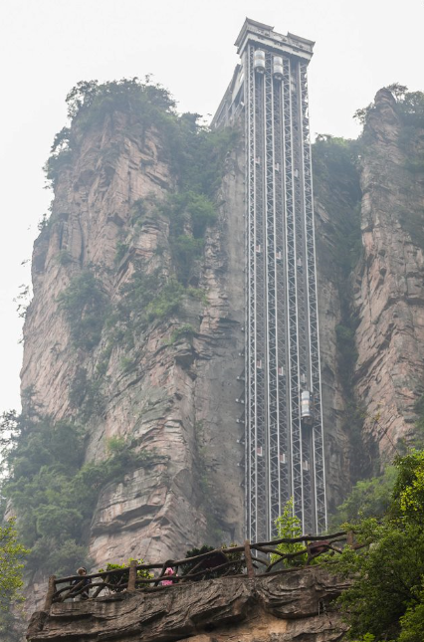
Lift/elevator
A high speed lift starting from the top of a multi-storey building is experiencing constant acceleration.
The design and maintenance of these elevators requires an understanding of uniform acceleration.
Highest outdoor elevator in the World in China (330m)

Slide 7
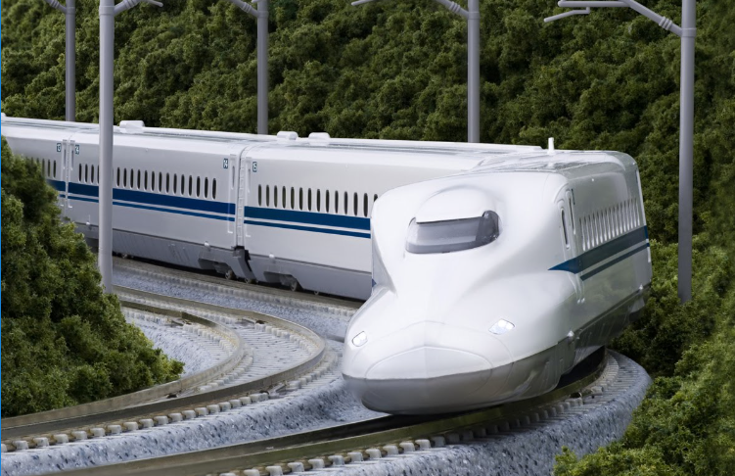
trains
Trains or any vehicle moving in a straight line applying a constant force, undergo uniform acceleration.
Track design, timetabling and train design require an understanding of uniform acceleration.
Shinkansen bullet trains in Japan. Top speed ~200mph

